Slide 1
Characters in Search of a doll’s house
Brett Butler MFA

Slide 2
Tell A Story
Each toy has its own background story. Be they action figures, dolls, superheroes or giant robots each product line has a rich “origin” to it. Use these elements as the basis of your photo shoot. Examples would be Star Wars toys interacting with everyday objects in your kitchen (or) how about small, green army men having a life of their own and invading your work-station when you leave the office. There are endless possibilities.

Slide 3
Examples: (Shot Gun Wedding) – (Boy’s School)

Slide 4
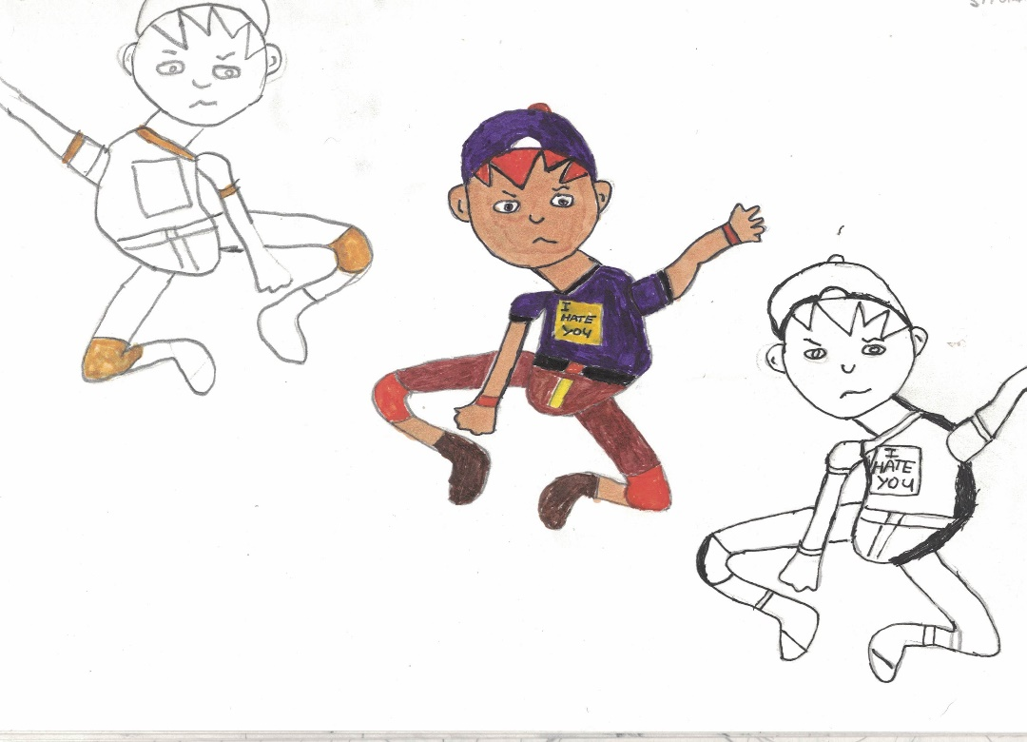
My Process
Picture the story in my mind
Sketch the story on paper with drawings and dialogue

Slide 5
My Process (continued)

Slide 6
My Process (continued)
Setup the scene to tell the story with props such as doll houses, backgrounds, furniture, trees, cars, people, dolls, pets, etc.

Slide 7
My Process (continued)
Assemble my toys as my cast of characters.
Pose them and compose my shots as if I were shooting a real human being.
Adjust lighting to suit the scene.
Photograph the scene adding and deleting the cast.

Slide 8
My process (Continued)
I publish eBooks
Review and select best photos (or) re-take photos if not satisfied with proper depiction of the story / results of the photo quality
Add effects to photos
Use photos as illustrations of a written story (or) accompanied by captions

Slide 9
My process (Continued)
I publish Zines
I create comics

Slide 10
Don’t be afraid to experiment
I started with writing stories, then photography, then drawing and have now put them all together by self-publishing and have a website archive of my work. I will be glad to provide information about that today. I also recently started creating posters of my favorite cover art.
The good thing about toy photography is that there are no set rules on how to do it right. As a photographer, you create your own style. You can have your pets interact with your toys too. Just fire away, you’re bound to get a few great “keepers”.

Slide 11
Infra-Red Camera

Slide 12
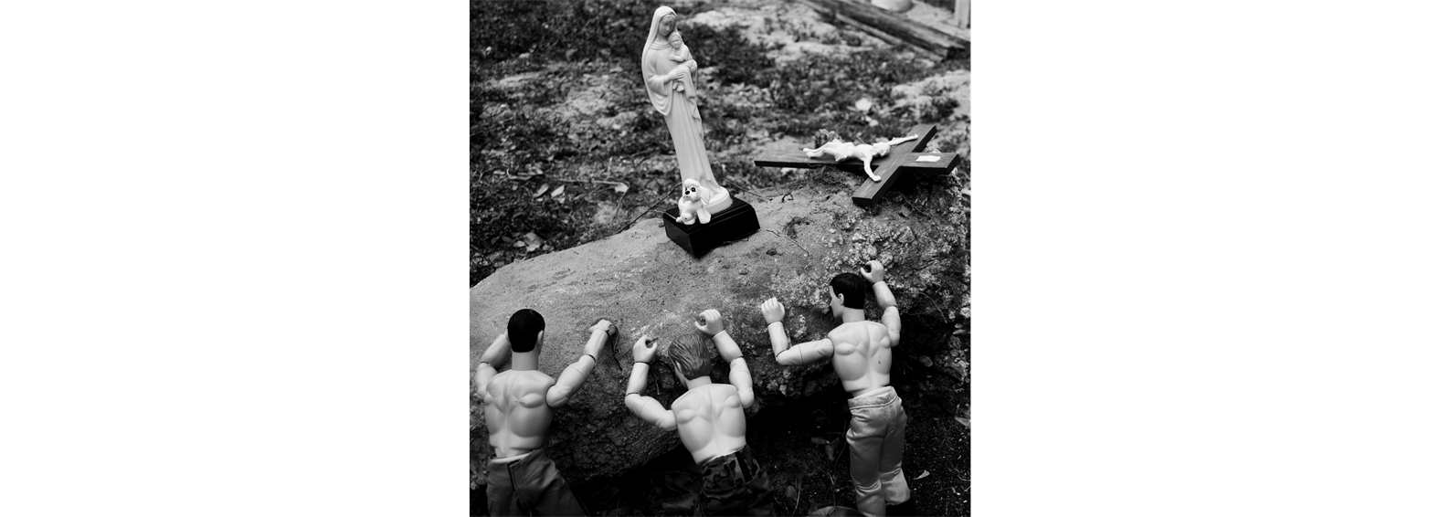
Black and white photography

Slide 13
Indoor Photography
The best areas inside your home are the kitchen, the living room, your home office or even your garage. Just imagine wild and fun scenes that your toys can make and you’ll have hours of fun.

Slide 14
Indoor Photography (public Places)

Slide 15
Indoor Photography (Using Mirrors)

Slide 16
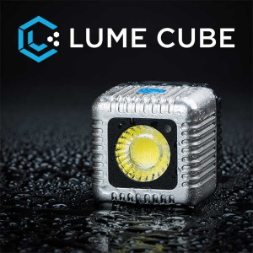
Indoor photography (Lighting I use)

Slide 17
Outdoor Photography
The outdoors are great for toy photography. You can combine and experiment with landscape photography and then apply your toys to all of nature’s splendor. You can start in your own backyard using natural sunlight.

Slide 18
Outdoor photography (in my yard)

Slide 19
Learn from others
The Internet allows you to check out the works of other hobbyist toy photographers. I follow the Star Wars Toys Flickr group and the Secret Life of Toys Flickr group so that I can see their works. More often than not, some photos will spark my own ideas on what I’ll integrate into my next photo-shoot or project. It’s also best to interact with the community and ask questions. They’ll be more than glad to offer help.

Slide 20
Share with others
I have lots of fun when I do my own photo-shoots and I’m sure to have more fun when reading the reactions of my friends when I share my toy photos. I use Facebook and my own website to share my photos. Even if I don’t make money from this, the input and constructive comments that I get are more than enough compensation for me. When someone smiles because of the photo of my toys, that’s reward enough for me.

Slide 21
The end

